Slide 1

Zomato Data Insights
This project simulates an Zomato Data Insights using Python Faker library, Python SQL, and Streamlit to analyze the Food Delivery Data for enhancing
operational efficiency and Improve the Customer Satisfaction
Saravanan
31/01/2025

Slide 2
Objective
Zomato Insights
Data Processing
Visualization
Analyze and visualize restaurant and food delivery trends using Zomato data to derive meaningful insights for business and user experience improvement.
Processes and stores data in a SQL database for querying and analysis.
Develops a Streamlit app to visualize Data insights and showcase SQL query outputs.

Slide 3

Business Use Cases
Restaurant Performance Analysis
Market Expansion Strategy
Analyze sales trends across different restaurants and regions.
Assess market saturation and performance of competitors to optimize new restaurant openings
Marketing and Promotions Optimization
Measure the success of marketing campaigns by tracking engagement
conversions, and reviews.

Slide 4




Technical Tags Used
Python
SQL
Streamlit

Slide 5

Methodology
1
Data Simulation
2
Database Creation
Generate a realistic dataset using the Faker library.
Create a SQL database schema and load the generated dataset.
3
Streamlit App Development
Develop a user-friendly web application for Operations
and query outputs.

Slide 6
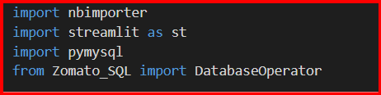
Data Generation with Libraries
Library’s used :
faker for Generate the Fake data
random for Random operations
pandas for Data handling
pymysql for MYSQL Database
nbimporter for importing .ipynb to .py scripts
streamlit for Visualization

Slide 7
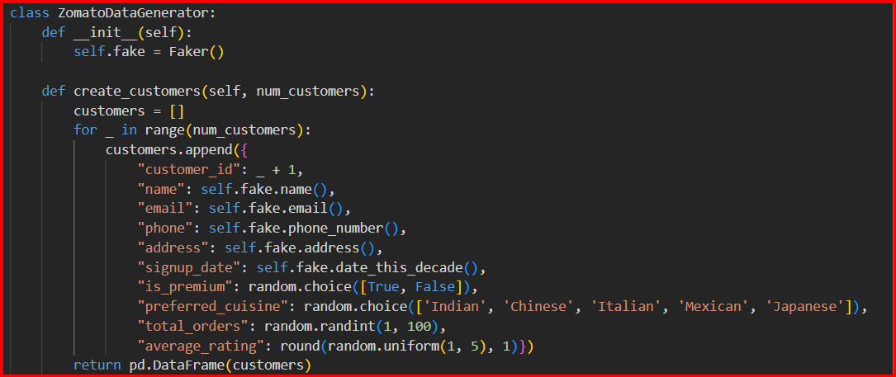
Categories & Data Generation: Detailed Descriptions
The customer data provides valuable insights into the behavior and preferences of people who use Zomato to order food.
Restaurant data provides insights into the variety of offerings and performance of establishments listed on Zomato.
Order data is critical for understanding transaction volumes, user behavior, and restaurant sales.
Delivery data is essential for analyzing the logistics of food delivery services, ensuring timely deliveries, and understanding customer satisfaction with delivery.

Slide 8
Zomato Data Generation
Class: ZomatoDataGenerator
This class provides methods for generating synthetic Zomato-like datasets, including customers, restaurants, orders, and deliveries. It uses the Faker library to generate realistic data and random functions to add variability.
Functions in the Class:
create_customers(num_customers)
Generates customer details, such as:
Customer ID, Name, Email, Phone, Signup Date, Preferred Cuisine, Total Orders, and Average Rating.
Returns: A DataFrame containing the customer information.
create_restaurants(num_restaurants)
Generates restaurant details, including:
Restaurant ID, Name, Cuisine Type, Location, Owner Name, Contact Number, Rating, and Active Status.
Returns: A DataFrame with restaurant information.
create_orders(num_orders)
Generates order details:
Order ID, Customer ID, Restaurant ID, Items Ordered, Quantity, Delivery Time, Order Status, Payment Mode, and Total Amount.
Returns: A DataFrame containing the order details.
create_deliveries(num_deliveries)
Generates delivery details:
Delivery ID, Order ID, Delivery Person, Delivery Status, Distance, Delivery Fee, and Vehicle Type.
Returns: A DataFrame containing the delivery details.

Slide 9
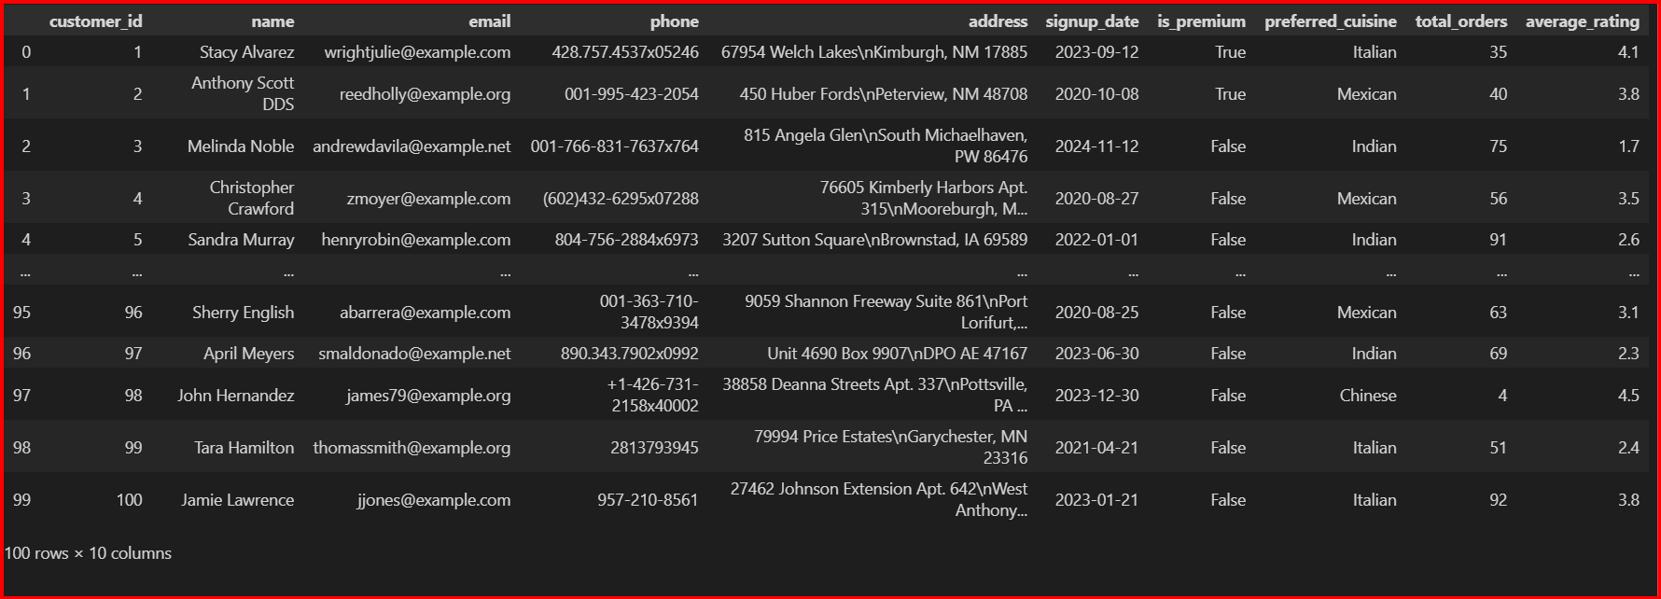
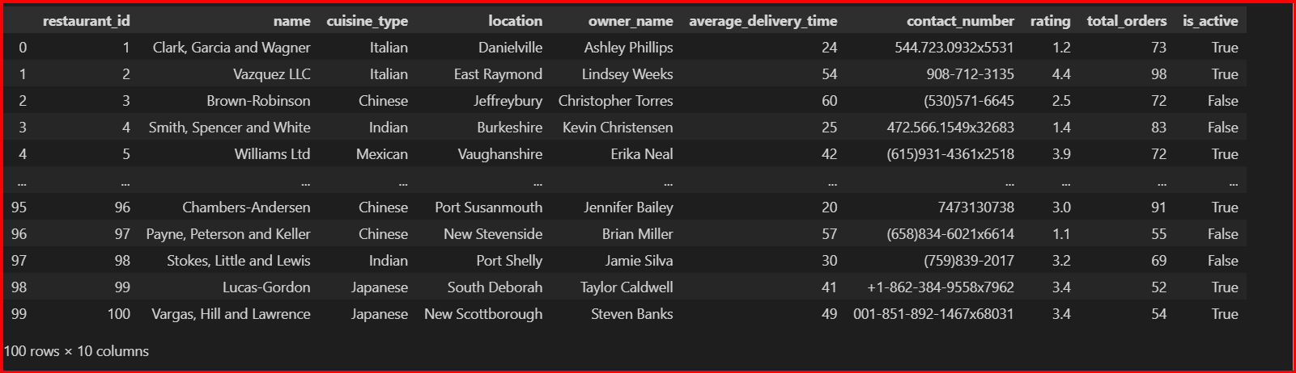
DataFrame Output
The function returns a Pandas DataFrame, a highly efficient data structure for data analysis and manipulation in Python. This DataFrame contains columns for customers ID as Primary key, Name, email, phone, address, signup_date, is_premium , Preferred_cuisine, total_orders, average_rating and so on so forth and This is just about Customers Table and there are Four Dataframes has created namely Customers Table, Restuarents Table, Orders Table, Deliveries Table.

Slide 10
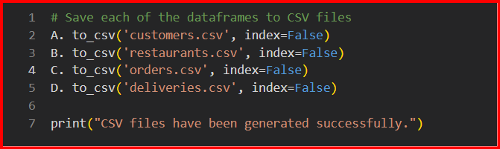
Save as CSV
The generated dataset from Zomato Data Insights Data Frames will be saved as four different CSV Files

Slide 11
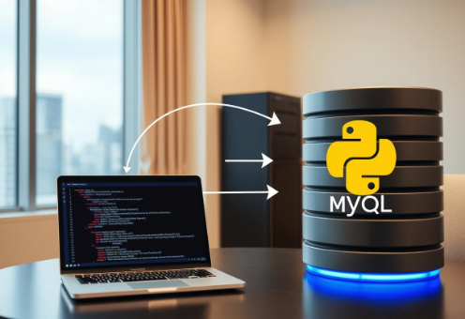
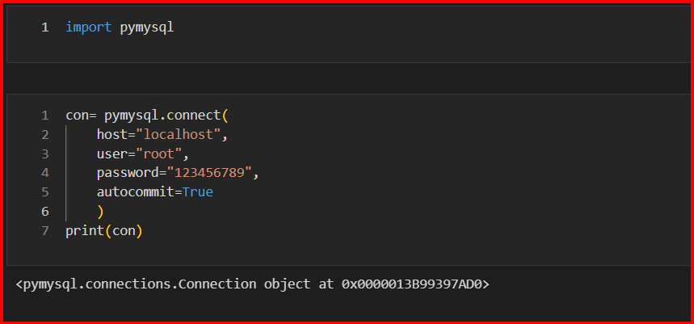
Connecting Python to MySQL
Import the necessary library: Begin by importing the `pymysql` library, which provides the necessary functions to interact with MySQL databases from Python. Use the statement: import pymysql
Establish a database connection: Create a connection object using the `pymysql.connect()` method. This requires specifying connection parameters such as host, user, password, and database name. For example: conn = pymysql.connect(host='your_host', user='your_user', password='your_password', database='your_database')
Create a cursor object: A cursor object allows you to execute SQL queries. Create one using: cursor = conn.cursor()
Load CSV data into a Pandas DataFrame: Read your CSV data into a Pandas DataFrame using: df = pd.read_csv('your_file.csv') Ensure the Pandas library is imported: import pandas as pd
Create a MySQL database and table: If the database and/or table don't exist, create them using SQL queries executed via the cursor. For example: cursor.execute("CREATE DATABASE IF NOT EXISTS your_database") cursor.execute("USE your_database") cursor.execute(""" CREATE TABLE IF NOT EXISTS your_table ( id INT AUTO_INCREMENT PRIMARY KEY, column1 VARCHAR(255), column2 INT, column3 DATE ) """) Adapt the table schema (column names and data types) to match your CSV data.
Insert data into the table: Iterate through the Pandas DataFrame and insert each row into the MySQL table using parameterized queries to prevent SQL injection vulnerabilities. For example: for index, row in df.iterrows(): cursor.execute("INSERT INTO your_table (column1, column2, column3) VALUES (%s, %s, %s)", (row['column1'], row['column2'], row['column3'])) conn.commit()
Close the connection: After completing all operations, close the database connection using: conn.close()

Slide 12
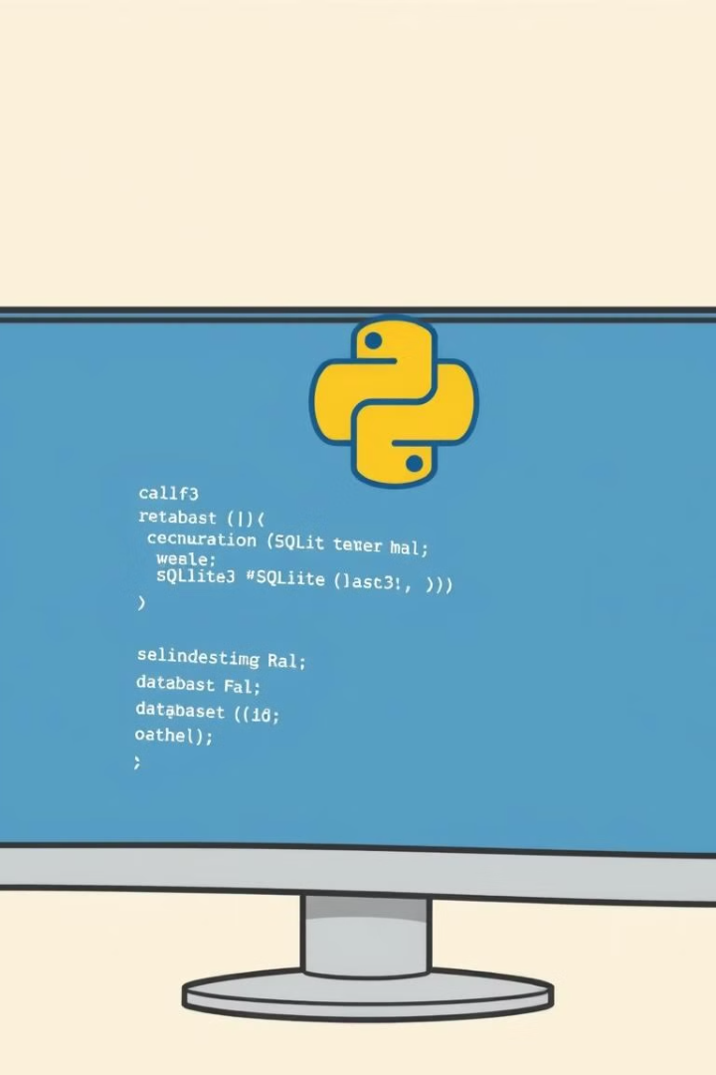
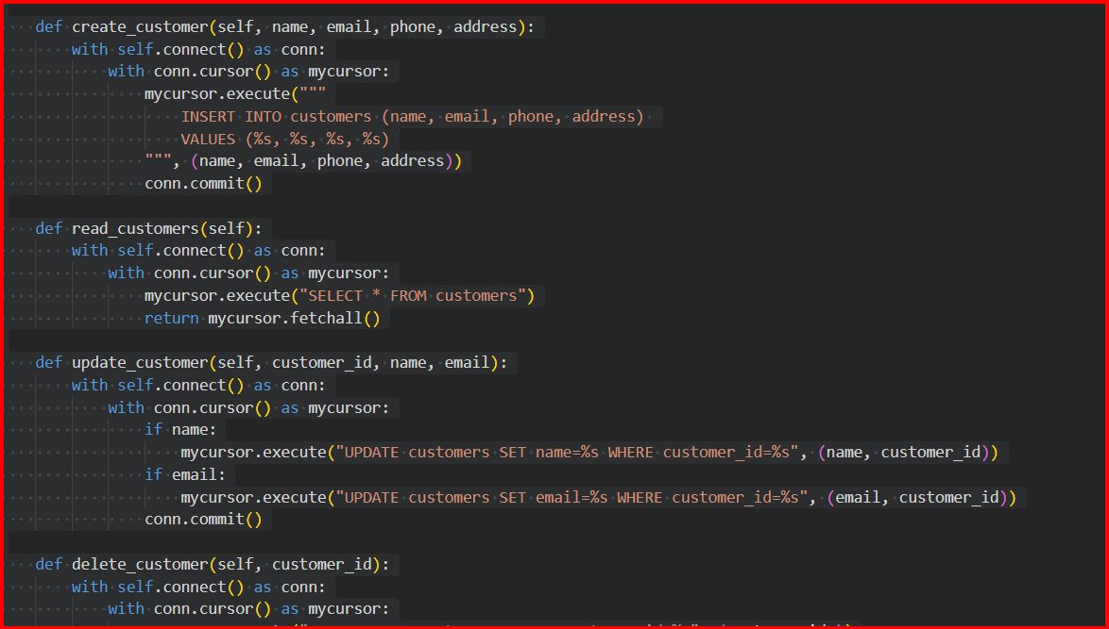
Crud Operations using MySql
This DatabaseOperator class provides methods to perform CRUD (Create, Read, Update, Delete) operations on a MySQL database for Zomato-like tables including Customers, Restaurants, Orders, and Deliveries.
1. Create
Insert new records into tables using:
create_customer(): Adds a customer record.
create_restaurant(): Adds a restaurant record.
create_order(): Adds an order record.
create_delivery(): Adds a delivery record.
2. Read
Retrieve data from tables using:
read_customers(): Fetches all customer records.
read_restaurants(): Fetches all restaurant records.
read_orders(): Fetches all order records.
read_deliveries(): Fetches all delivery records.
3. Update
Modify existing records using:
update_customer(): Updates customer details (name or email).
update_restaurant(): Updates restaurant details (name or location).
update_order(): Updates order items or quantity.
update_delivery(): Updates delivery status.
4. Delete
Remove records from tables using:
delete_customer(): Deletes a customer by ID.
delete_restaurant(): Deletes a restaurant by ID.
delete_order(): Deletes an order by ID.
delete_delivery(): Deletes a delivery by ID.

Slide 13

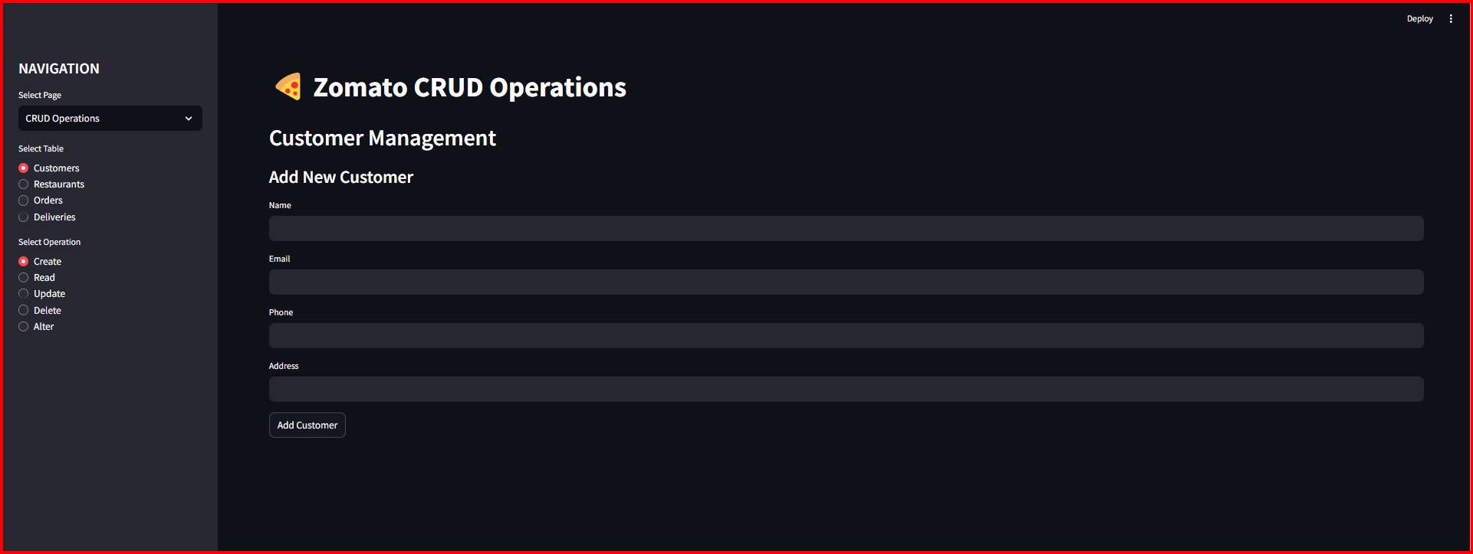
CRUD Operations using Streamlit
CRUD Operations
CRUD stands for Create, Read, Update, and Delete-- essential operations for interacting with databases. This Streamlit app provides a user-friendly interface to perform these operations on various tables like Customers, Restaurants, Orders, and Deliveries:
Create: Add new records, such as customers, restaurant entries, orders, and delivery details.
Read: Display and view existing records in a tabular format for better insights.
Update: Modify specific record details based on unique identifiers like customer or restaurant IDs.
Delete: Remove unwanted or obsolete records from the database.
Alter: Dynamically add new columns to tables with user-defined data types for schema modifications.

Slide 14
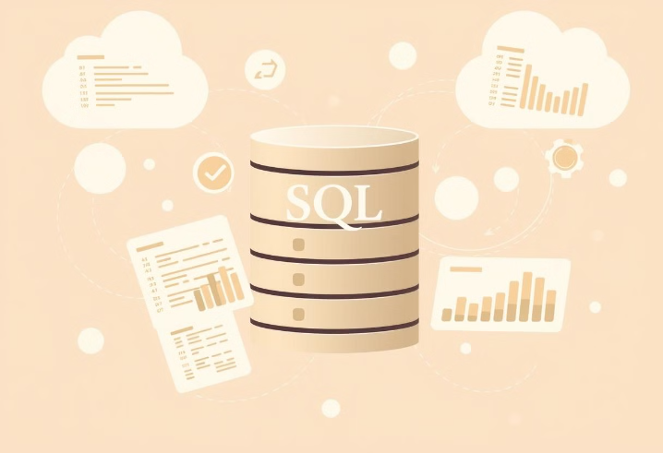
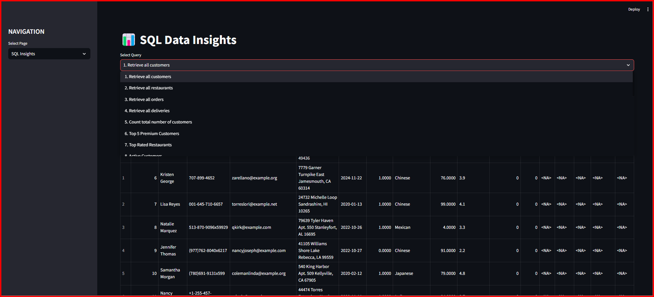
SQL Query Insights using Streamlit
SQL Query Insights
The app provides a comprehensive suite of pre-defined SQL queries to analyze and gain insights from the Zomato database, such as:
Customer Insights: Total customer count, premium customer trends, and active users.
Order Analytics: Orders placed in the last week, monthly revenue trends, and average order value.
Delivery Efficiency: Delivery status breakdowns and pending delivery insights.
Restaurant Performance: Top-rated restaurants, revenue breakdown, and restaurants with zero orders.
Business Insights: Identifying highest-earning restaurants, repeat customer counts, and top-spending customers.

Slide 15

Project Insights and Key Learnings
Project Takaways
Throughout this project, I gained comprehensive skills in dataset generation using the Faker library, including creating multiple CSV files and connecting the Data Base as well as done with CRUD operation and Analyzing Insights with the Streamlit Application.

Slide 16

Thank you for this opportunity. This project has been an invaluable learning experience that has significantly expanded my skills and knowledge in data analysis, programming, and exploring the Domain insights.

